Slide 1
Introduction to Parkinson’s disease
Anne Martin
Parkinson's Disease and related movement disorders nurse specialist

Slide 2
Aims
History
What, Why, When, Who
Drug therapies
Management of the 4 stages of Parkinson’s disease (PD)
Neuropsychiatry complications
The Future

Slide 3
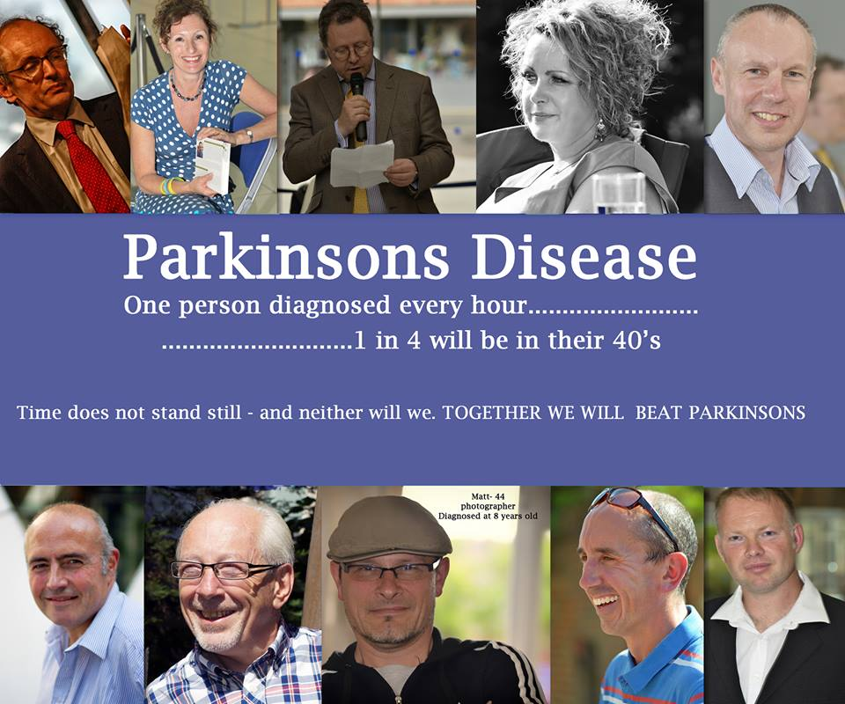
Perception of IPD

Slide 4
History of Parkinson’s disease?
James Parkinson’s essay in 1817
40 years later - Charcot named PD
Hassler 1st described the basal ganglia in 1938
Levodopa - 1957 in animals
Cotzias used Levodopa 1967
Stochdorph discovered Lewy bodies in the basal ganglia in 1979

Slide 5



James Parkinson

Slide 6
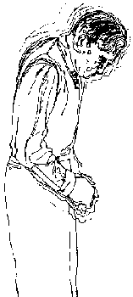
What is Parkinson’s disease?

Slide 7
What is Parkinson’s disease?
Chronic, progressive, neurological degenerative disease
degeneration of dopaminergic neurones in substantia nigra
80- 90% depletion of dopamine in the substantia nigra
Lewy bodies usually seen in PD but also seen in other conditions (i.e. Dementia)
Notes:
A chemical produced by the brain; it assists in the effective
transmission of electrochemical messages from one nerve cell
to the next. It is deficient in the basal ganglia and Substantia
Nigra of a person with Parkinson's. It governs actions of
movement, balance and walking.
The nigro-striatal pathways consist of dopaminergic
neurons which originate in the substantia nigra (black
substance) in the midbrain and project to the striatum (basal
ganglia), indirectly controlling involuntary motor movement.
Parkinson's disease results from degeneration of these
neurons with depletion of dopamine from the neuron
terminals and a loss of control of involuntary motor control
(tremor, rigidity, etc) mediated by the extra-pyramidal
pathways. This forms the basis for the administration of the
dopamine precursor, l-dopa as replacement therapy,
dopamine agonists, and drugs which indirectly facilitate
dopamine activit

Slide 8
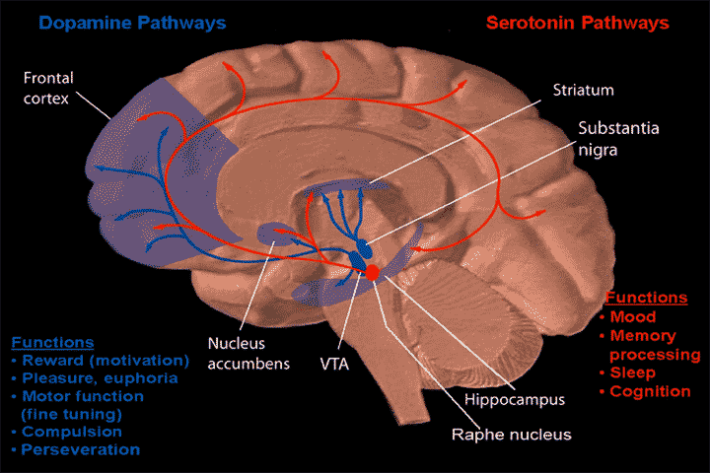
Pathology & Pathways
Reduced level of dopamine
Loss of dopaminergic cells in the substantia nigra
Other neurotransmitters: serotonin, acetylcholine
Symptoms of PD only manifest themselves: 70- 80% loss of dopaminergic cells
Notes:
The cause of PD itself and the characteristic of the disease is caused by a reduction in the amount of dopamine in the brain.
This drop in neurotransmitter is due to the gradual loss of the dopamine producing cells namely the dopaminergic cells in the substantia nigra.
However, it has been recently discovered that other chemicals in the brain are also involved in the disease such as serotonin ( happy hormone) and acetylcholine.

Slide 9
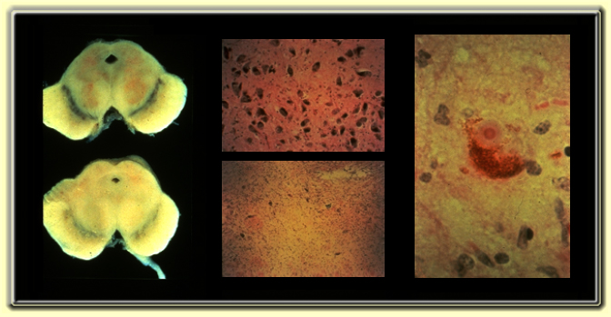
Pathology of Parkinson’s Disease

Slide 10

Lewy Body

Slide 11
Cont.
Dopamine acts to inhibit acetylcholine
Dopamine inhibitory
Acetylchloline excitatory
Depletion in dopamine results in hypokinetic disorders such as PARKINSON’S DISEASE

Slide 12
Other interesting bits
Subthalamic nucleus, thalamus & hypothalamus - Diencephalon
afferent - bringing info to, having an affect (ordering)
efferent - responding to info, having an effect (reporting)

Slide 13
Signs and Symptoms

Slide 14
Diagnostic criteria
Bradykinesia plus one of the following:
  resting tremor 4-6Hz ‘ pin rolling’
  Rigidity - lead pipe or cogwheeling
  disorders of posture - flexion of neck & trunk
  disorders of balance- loss of righting reflex
  disorders of gait - shuffling, festination, freezing,
Onset: Insidious, unilateral progressing to bilateral

Slide 15
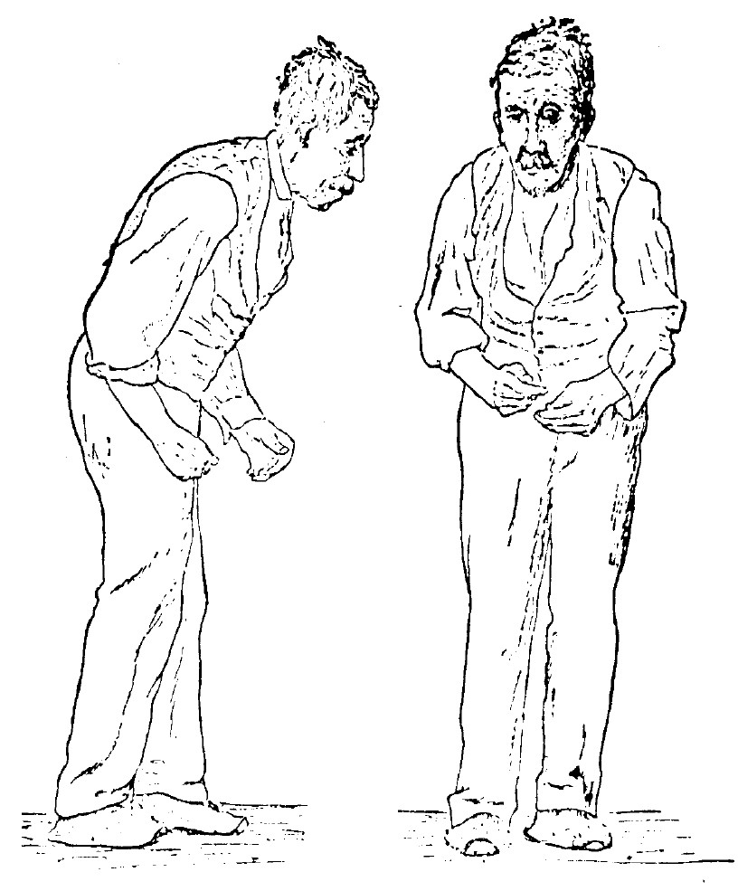
Typical PD features
Tremor Dominant
Akinetic type
Mixed Type
Muscle rigidity
Tremor
Bradykinesia - a slowing of physical movement
In advanced PD: akinesia - a loss of physical movement.
N.B: A range of non- motor symptoms
Notes:
As the picture shows a typical posture for a person with PD: stooped forward posture, shuffling gait, ‘poker’ face, postural instability.

Slide 16
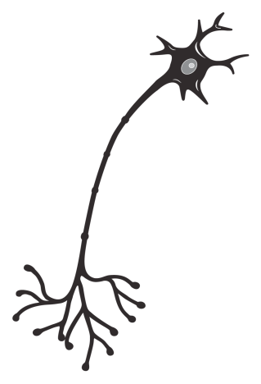
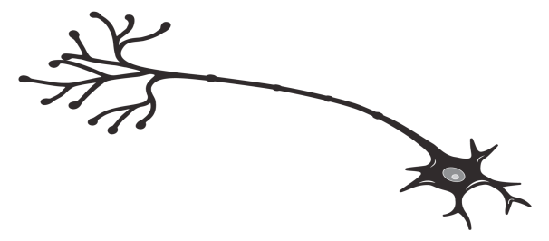

Constant levels of dopamine are vital for normal movement
In the brain, constant levels of dopamine are required to
  Regulate cortical excitation of striatal neurons
  Stabilize the firing rate and excitability of striatal neurons
  Modulate plasticity of striatal neurons (long-term potentiation)
Excitatory cortical input
Dopaminergic
regulatory input
Substantia
nigra
Striatum
Basal ganglia
Normal motor function
Olanow et al, 2006
Notes:
16
Dopamine exerts presynaptic modulation (in both up and down directions) on the glutamate-mediated excitation of striatal medium spiny neurons.
Most striatal neurons are medium spiny neurons that receive massive glutamatergic inputs from the cortex and thalamus
Regulation of this neuronal activity requires a precise selection mechanism (ie dopamine modulation) to filter incoming and outgoing signals associated with movement
Dopamine also acts postsynaptically to stabilise the firing rate and excitability of striatal neurons
It has also been recently shown that a key function of dopamine is to modulate glutamate-mediated long-term potentiation and long-term depression, thereby regulating plasticity of striatal neurons
Olanow et al. (2006) Lancet Neurol 5: 677–687

Slide 17
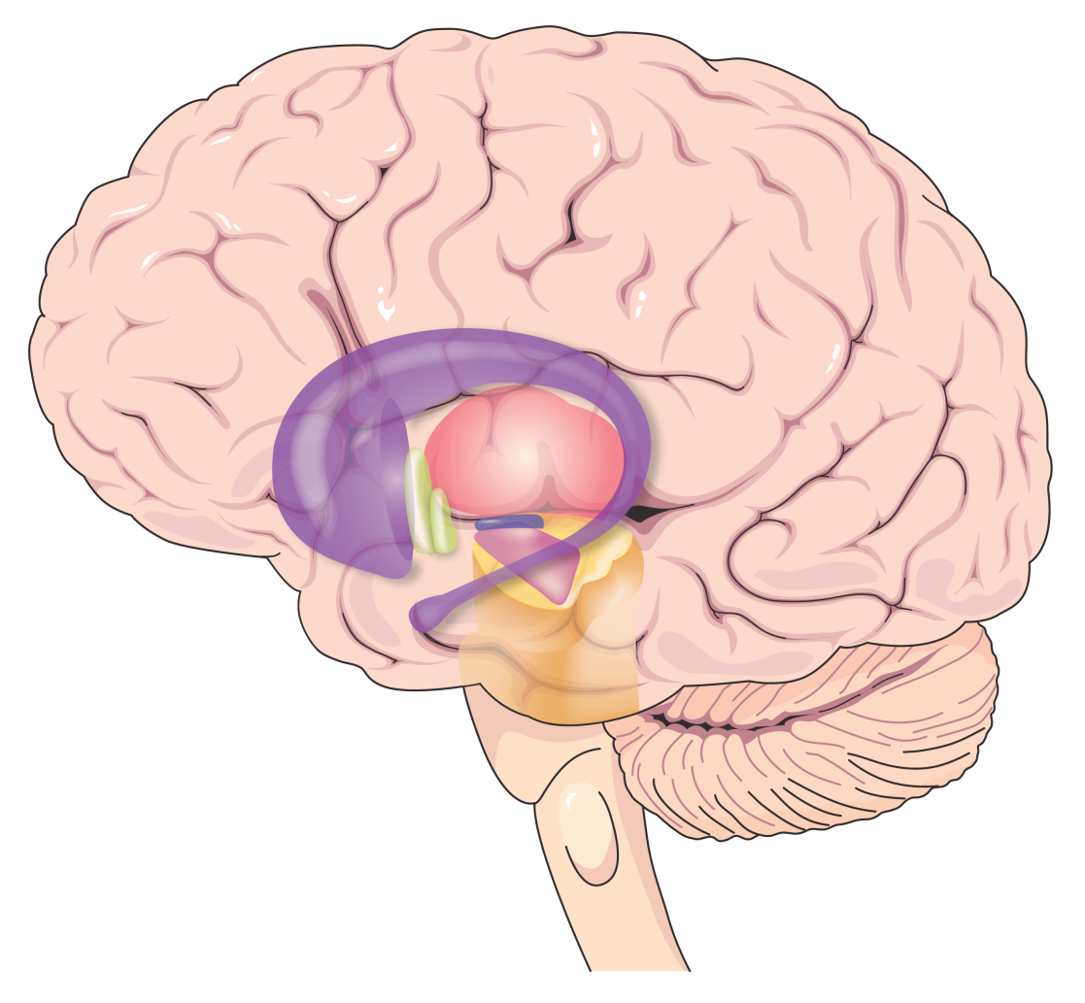
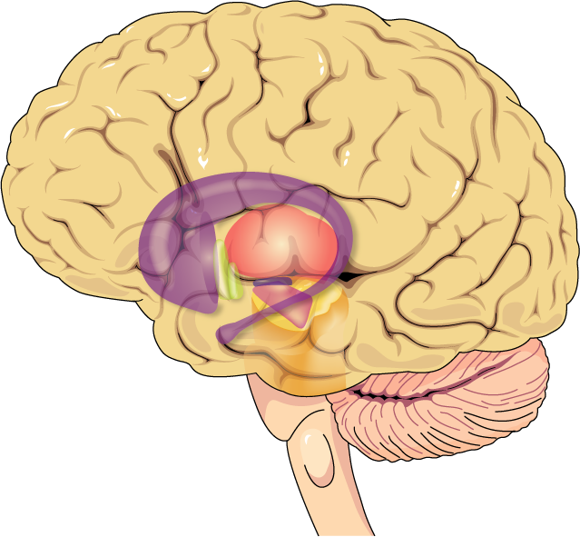
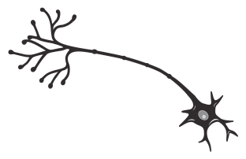
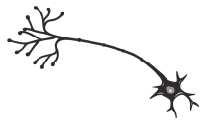
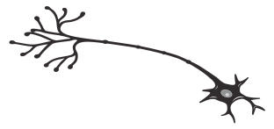
In PD, pulsatile delivery of traditional levodopa leads to pulsatile stimulation of dopamine receptors
Dopamine receptor state
Normal
Activated
Unactivated
Striatum
PD (untreated)
Substantia nigra
Activated
Unactivated
Nigrostriatal neurons
degenerate
Traditional levodopa
Activated
Traditional
levodopa
Unactivated
Notes:
17
With continued neuronal degeneration, plasma levodopa concentrations cannot be buffered and result in fluctuations in striatal dopamine levels
Under normal circumstances, dopamine neurons fire continuously, therefore, striatal dopamine receptors are normally exposed to relatively constant levels of dopamine and are in a constant state of activation
In PD, there is a progressive degeneration of nigral dopaminergic neurons and striatal dopamine levels become increasingly dependent on plasma levodopa concentrations
However, levodopa has a short plasma half-life and does not provide dopamine to striatal receptors in a continuous and physiologic manner
With continued neuronal degeneration, fluctuations in plasma levodopa concentration are translated into fluctuations in striatal dopamine levels and striatal dopamine receptors now become exposed to alternating high and low levels of dopamine resulting in ‘pulsatile stimulation’
Olanow et al. (2006) Lancet Neurol 5: 677–687

Slide 18
Normal Movement

Slide 19
















Dopamine
Striatal dopamine receptors
Nigrostriatal nerve terminals
Striatal neurone
Activated receptor
Normal neuronal function

Slide 20
Parkinsonian State

Slide 21


Striatal dopamine receptors
Nigrostriatal nerve terminals
Dopamine
Striatal neurone
Nigrostriatal nerve terminals
Activated receptor
Unactivated receptor
Normal neuronal function

Slide 22
Parkinsonian State with Intermittent Levodopa

Slide 23
Dopamine made from levodopa
Striatal dopamine receptors
Nigrostriatal nerve terminals
Striatal neurone
Activated receptor
Unactivated receptor
Normal neuronal function

Slide 24
Making a diagnosis
History
Examination
dopaminergic response
Time
SPECT or PET scans

Slide 25
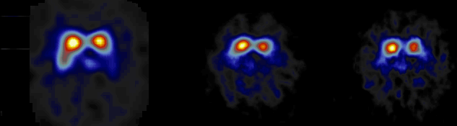
SPECT and progression
Baseline 15months 23months

Slide 26
Additional presenting symptoms
Facial
  impassivity, poverty of blinking,
Speech
  monotonous, hypophonic
Movement
  ↓ manual dexterity, rigid hands & arms ‘frozen shoulder’
Olfactory abnormalities
dribbling of saliva / swallowing difficulties

Slide 27
Cause of PD
Unknown in most cases
Genes
  13 identified
  AD inheritance very rare; mutation unknown
  mutation of Alpha synuclein gene identified in one large Italian and 5 Greek autosomal dominant families
  mutation of parkin gene in AR juvenile parkinsonism - Lewy body negative

Slide 28

Causes cont.
Environment
  Majority of cases believed caused by environmental factor (s) but none identified so far
Genes plus environment?
Genetic susceptibility

Slide 29
Parkinson’s disease risk factors
Definite: Old age
Highly likely: MZ co-twin with early- onset PD
Probable: Positive family history
Possible: Herbicides, pesticides, heavy metals, proximity to industry, rural residence, well water, repeated head trauma, etc.
Possible protective effect: Smoking

Slide 30
How common is Parkinson’s disease?
Incidence 20 per 100, 000
prevalence - 160 - 200 per 100, 000
approx 120, 000 people with PD in the UK (2003)

Slide 31
Pharmacologic Treatment of Parkinson’s Disease

Slide 32
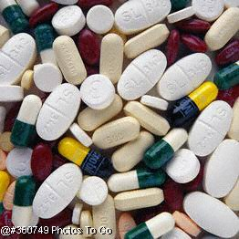
Drug Classes in PD
Dopaminergic agents
  Levodopa
  Dopamine agonists
COMT inhibitors
MAO-B inhibitors
Anticholinergics
Amantadine

Slide 33
Levodopa
Most effective drug for parkinsonian symptoms
First developed in the late 1960s; rapidly became the drug of choice for PD
Rapid peripheral decarboxylation to dopamine without a decarboxylase inhibitor (DCIs: carbidopa, benserazide)
Side effects: nausea, postural hypotension, dyskinesias, motor fluctuations

Slide 34
Levodopa Preparations
Co-Careldopa (Sinemet 62.5mg, Sinemet Plus 125mg)
Co-Cabenoldopa (Madopar Cps., soluble Madopar)
Stalevo (50mg,100mg,150mg,200mg, Combination Sinemet+Entacapone)
Duodopa

Slide 35
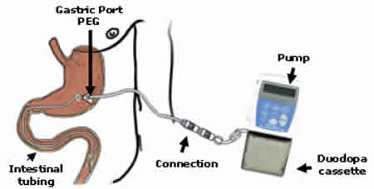
Duodopa Infusion

Slide 36
Is Levodopa Toxic?
Early patients develop motor fluctuations, but may be a function of neuronal cell loss
Increased life expectancy with LD introduction
LD-naive advanced PD patients develop fluctuations almost immediately with LD induction
Some believe continuous infusion may be safer than pulsatile therapy

Slide 37
Levodopa complications
Dose failure - Patient not aware of effect of individual dose
Mid-afternoon loss of benefit - super OFF
Loss of sleep benefit; early-morning akinesia, possible foot dystonia
Regular “wearing off” every 4 hours at first, shortens with time
Frequent wearing off, abrupt on-off, unpredictable dose response
Dyskinesia

Slide 38
Levodopa-Induced Dyskinesias
Manifestation of excessive dopaminergic stimulation
Typically late effect, and with higher doses
Narrowing of therapeutic window
Rare in LD-naive patients on DA monotherapy
Most common is “peak dose” dyskinesia
  disappears with dose reduction
Choreiform, ballistic and dystonic movements
Most patients prefer some dyskinesias over the alternative of akinesia and rigidity

Slide 39
Dopamine deregulation (DDR)
The need to take more medication that is required to control symptoms
Excessive use of prescribed medications
The requirement to acquire medications usually from the internet to meet the “need”
Leading to hallucination psychosis and addiction

Slide 40
Impulse control disorder (icd)
Gambling hyper sexuality compulsions: eating, shopping, internet use, kleptomania
Hobbyinism, hedonistic behaviours,
Psychosis, paranoia, punding, night time eating
Obsessive behaviours in relationships
“become liars”

Slide 41
Dopamine Agonists: Distinguishing Features
Directly stimulate dopamine receptors
No absorption delay from competition with dietary amino acids
Longer half-life than levodopa
Monotherapy or adjunct therapy
May delay or reduce motor fluctuations & dyskinesias associated with levodopa
May be neuroprotective

Slide 42
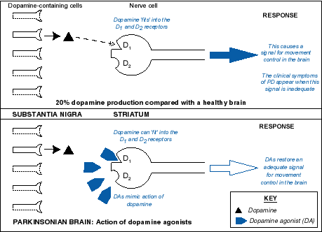
Action of DA ’s

Slide 43
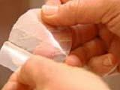
Dopamine Agonists (DA) used in PD
Pramipexole ( Mirapex,max.4.5mg salt base) both TDS and PR
Ropinirole/Ropinirole XL (Requip/Requip XL,max.24mg)
Rotigotine Skin Patch ( Neupro, max.16mg)
Cabergoline (Cabaser, max. 4mg)
Apomorphine (Apo-G0) SC continuing infusion or pen jets
(Pergolide,Bromocriptine) which are rarely used or are being with drawn

Slide 44
DAs: Common Adverse Effects
Nausea, vomiting
Dizziness, postural hypotension
Headache
Dizziness
Drowsiness & somnolence
Confusion, hallucinations, paranoia
pulmonary & retroperitoneal fibrosis; pleural effusion & pleural thickening; Raynaud’s phenomena. (May be more common with ergot derived DA’s)

Slide 45
Side effects
Pramipexole: compulsive eating,hyper sexuality, weight gain,
Requip: psychosis, hallucinations,paranoia,Reynard's type syndrome,
Apo-Go: hypersexuality
Cabergoline: hallucinations and illusions

Slide 46
Apomorphine
D1/D2 agonist
Parenteral delivery (s.c.)
Rapid “off” period rescue
  2-7 mg s.c pen injection systems
Treatment of unpredictable, frequent motor fluctuations
  continuous ‘waking hours’ s.c. (24hrs)infusion via mini-pump
SE: nausea, vomiting, hypotension
  domperidone 20 mg tds

Slide 47
Apo-Go pen jets
Rescue remedy for off periods and for dystonia’s. (muscle cramping)
1-6mg
Pen for pain
Can be abused and again lead to paranoia and psychosis

Slide 48
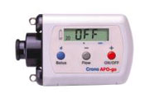
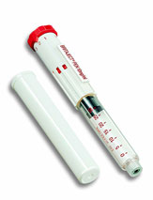
Apo-Go

Slide 49
COMT Inhibitors
Entacapone 200mgs (comb.Stalevo)
Potentiate LD: prevent peripheral degradation by inhibiting catechol O-methyl transferase
Reduces LD dose necessary for a given clinical effect
Helpful for fluctuating Parkinson’s disease
May be particularly useful for patients who fluctuate between off and on states frequently throughout the day

Slide 50
Entacapone
Dosage: 200 mg with each Levodopa dose.
Parkinson’s Study Group 1997: Increased on time by 5%, more in pts w/least on time
Rinne et al., 1998: Increased on time by ~10%; decreased Levodopa
Body fluids – reddish brown
Diarrhoea, dopaminergic SE’s

Slide 51
stalevo
Stavelo contains Entacapone and Levodopa combined.
Reduces the amount of tablets need to be taken when on combined entacapone and sinemet separately
50mg 75mg 100mg 150mg 200mg
200mg can be taken over night which last longer than sinemet CR

Slide 52
Amantadine
Antiviral agent; PD benefit found accidentally
Tremor, bradykinesia, rigidity & dyskinesias
Exact mechanism unknown; possibly:
  enhancing release of stored dopamine
  inhibiting presynaptic reuptake of catecholamines
  dopamine receptor agonism
  NMDA receptor blockade
Side effects —autonomic, psychiatric
100-300 mg/day usually 100mg BD morning and afternoon

Slide 53
Selegiline
Irreversible MAO-B inhibitor
Clinically active by inhibiting dopamine metabolism in brain
May be neuroprotective
Dosage: up to 5mg od
Side effects: insomnia, hallucinations, nausea (rarely)
Potential interactions with tricyclics and SSRI antidepressants

Slide 54
Rasagaline
1mg OD
Similar to selegeline affect without the amphetamine issues
replaces(newish Tolcapone (Tasmar) strict guidelines for use) Talcapone can only be used with monthly blood tests.

Slide 55
Rasagaline
1mg OD
Similar to selegeline affect without the amphetamine issues
replaces(newish Tolcapone (Tasmar) strict guidelines for use) Talcapone can only be used with monthly blood tests.

Slide 56
Anticholinergics
Dopaminergic depletion→ cholinergic overactivity
Initially used in the 1950s
Effective mainly for tremor and rigidity
Common agents (Start low, go slow):
  Benzhexol
  Orphenadrine
Side effects:
  Dry mouth, sedation, delirium, confusion, hallucinations, constipation, urinary retention
  Difficult to withdraw

Slide 57
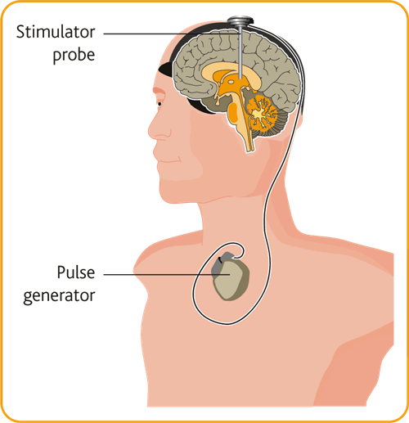
Deep Brain Stimulation (DBS)

Slide 58
The four stages of Parkinson’s disease
Diagnostic
Maintenance
Complex
Palliative

Slide 59
Diagnosis
Achieve acceptance of the diagnosis
reduce distress
control symptoms
improve prognosis

Slide 60
Aims of care in Early Parkinson’s disease
Provide symptomatic relief
Reduce functional disability
Reduce or delay long-term complications of drug therapy
  motor fluctuations
  dyskinesia
Slow disease progression: “neuroprotection”

Slide 61
Aims of the Maintenance phase
Morbidity relief
Prevention of complications
Maintenance of good health

Slide 62
Multidisciplinary team input in the early and maintenance stages of PD
Early referral essential
PDNS
Physiotherapy
SALT
Social worker
Dietician
Early  Maintenance period 8 - 10 years

Slide 63
Management of the Complex phase of PD
Motor
  ON/OFF fluctuations, dyskinesias, dystonia, freezing, falls
Behavioral / neuropsychological
  depression, sleep disorders, psychosis, apathy
Autonomic
  orthostatic hypotension; hyperhidrosis,(drooling) constipation, impotence, urinary incontinence or retention

Slide 64
H and Y stage 5
Living wills/ directives
Palliative care input
Nutritional advice/PEG’s
End of life discussions
Pain advice
Ldopa treatment assessment:Patch/Apo-Go to prevent off periods and rigidity QOL leading to QOL of dying

Slide 65
MSA
What are the first signs of MSA?
Other early problems can be feeling stiff and slow and finding movement difficult, feeling dizzy when standing up, fainting, difficulty turning in bed, and changes in writing. Some people become clumsy or unsteady when walking.
However these early symptoms could also be due to a range of other diseases which need to be excluded before a diagnosis of MSA can be made.

Slide 66
MSA
Multiple System Atrophy (MSA) is a progressive neurological disorder that affects adult men and women. MSA is caused by degeneration of nerve cells in specific areas of the brain. This cell degeneration causes problems with movement, balance and automatic functions of the body such as bladder control.

Slide 67
MSA
Broken down MSA stands for:
Multiple - many
System - brain structures that control different functions
Atrophy - cell shrinkage or damage
This means that cells are damaged in different areas of the brain that control different body functions. The three areas affected are the basal ganglia, cerebellum and brain stem. These areas are responsible for movement, balance and automatic body functions like bladder control.

Slide 68
What else happens in MSA?
There are three groups of symptoms. They are sometimes called
parkinsonism (slow, stiff movement),
cerebellar(co-coordinating movement and balance)
autonomic(automatic body functions)

Slide 69
MSA
Parkinsonism
feeling slow and stiff when moving
difficulty turning in bed
difficulty in starting to move
writing becoming small and spidery

Slide 70
MSA
Cerebellar
feeling clumsy, dropping things
finding it difficult to fasten buttons
feeling unsteady in crowds
unable to balance without support
difficulty writing
slurred speech

Slide 71
Autonomic
bladder problems
difficulty with erections
feeling dizzy or fainting (blood pressure problems)
pain around neck and shoulders
constipation
cold hands and feet
inability to sweat

Slide 72
MSA
weakness in arms and legs
heightened emotional response, laughing or crying
restless sleep
nightmares
noisy breathing during the day, snoring at night
unintentional sighing
swallowing problems, difficulty chewing, choking episodes
weak, quiet voice

Slide 73
MSA
Movement problems - drugs to help stiffness and slowness are the same drugs used in Parkinson's disease (PD). They are not as effective in MSA and can make blood pressure problems worse. It may take time to find what suits you best.
L-Dopa (Madopar or Sinemet)
Amantadine (Symmetrel)

Slide 74
Blood pressure problems
Fludrocortisone (Florinef) - A steroid, taken in very small doses; may cause ankle swelling.
Ephedrine - Works quickly to raise the blood pressure, usually taken three times a day.
Midodrine (Gutron) - Works quickly to raise the blood pressure (within 30-60 minutes), usually taken three times a day. Only prescribed by specialists.

Slide 75
Bladder problems
drugs can reduce urgency and frequency problems
Oxybutinin (Ditropan) - improves bladder control
DDAVP (Desmopressin) - used to reduce the production of urine overnight
Antibiotics - should be prescribed at the first signs of infection. Any infection in someone with MSA can worsen symptoms like postural hypotension dramatically.

Slide 76
What are the first signs of MSA?
For men, the first sign is often erectile dysfunction (unable to achieve or sustain an erection). Both men and women often have early bladder problems: urgency, frequency, incomplete bladder emptying or an inability to pass urine (retention). These problems may sometimes be incorrectly attributed to the ageing process or to prostrate disease in men.

Slide 77
MSA
3-5 years life expectancy with MSA type C
5-12 years MSA type P
Falls forward from diagnosis
Hypotension and postural hypotension
Drooling
Early Palliative input/Sudden death
and weight-loss, may appear.

Slide 78
Progressive supra nuclear Palsy
Progressive Supranuclear Palsy (PSP) is a degenerative brain disease which affects eye movement, balance, mobility, speech and swallowing.
P - Progressive - the disease gets steadily worse.
S - Supranuclear - the area affected is above ('supra') the nuclei in the brain.
P - Palsy - paralysis

Slide 79
PSP
Progressive Supranuclear Palsy (PSP) involves the progressive death of neurons (nerve endings) in the brain, mainly in the basal ganglia and brainstem, just above the nuclei (hence ‘Supranuclear' being a key part of its name).

Slide 80
PSP
The exact cause of PSP is unknown, however, there is now known to be a complex genetic component involved and the disease itself appears to be triggered environmentally and selectively, perhaps by any one of a variety of neurotoxins, or injury to the head.

Slide 81
PSP
The area affected in PSP controls balance, movement, vision (particularly upgaze and downgaze) speech and the ability to swallow, hence the main symptoms, some of which may not appear or progress at all or until later in the disease. Other symptoms, including behavioural changes

Slide 82
PSP
Over time PSP can rob a person of the ability to walk, talk, feed themselves or communicate effectively they have 60% risk of cognitive impairment
Usually debates regarding PEG/supra pubic catheter start early
Diagnosis 5-9 years

Slide 83
What is Lewy Body dementia?
Lewy bodies are abnormal microscopic protein deposits in the brain that disrupt the brain's normal functioning causing it to slowly deteriorate. The effects include a degradation of cognitive functioning, similar to Alzheimer's disease, or a degradation of motor control, similar to Parkinson's disease. Lewy bodies are named after Frederick Lewy who first observed their effects

Slide 84
DLBD
Lewy Body Dementia can start differently in people. Sometimes those with LBD initially have a movement disorder that looks like Parkinson's but later they also develop dementia symptoms. Others have a memory disorder that looks like Alzheimer's but they later develop hallucinations and other behavior problems.

Slide 85
DLBD
Over time most people with LBD develop a spectrum of problems that include great variations in attention and alertness from day to day, recurrent visual hallucinations, shuffling gait, tremors, and blank expression, along with various sleep disorders.

Slide 86
Signs and symptoms of Lewy Body dementia
Mental decline. Lewy Body patients may experience reduced alertness and lowered attention span.
Recurrent visual hallucinations or depression. Hallucinations, usually related to people or animals, occur in most LBD patients. Depression is also common.
.

Slide 87
DLBD
Increasing problems handling the tasks of daily living. Tasks that used to be simple may become difficult for a person with Lewy Body dementia.
Repeated falls and sleep disturbances. This includes insomnia and acting out dreams.
Fluctuations in autonomic processes. This includes blood pressure, body temperature, urinary difficulties, constipation, and difficulty swallowing

Slide 88
Parkinson’s, Alzheimer’s and Lewy Body dementia
Since Lewy Body dementia is commonly misdiagnosed for both Parkinson’s and Alzheimer’s, it is helpful to understand how these diseases overlap.

Slide 89
Parkinson’s and Lewy Body Disease
Some of the motor symptoms found in both Parkinson’s and Lewy Body Disease's patients include:
tremors
muscle stiffness
difficulties with balance
shuffling gait
stooped posture
slow movements
restless leg syndrome

Slide 90
Alzheimer’s and Lewy Body Disease
Some of the cognitive symptoms found in both Alzheimer's and Lewy Body's patients include:
behavioural changes
decreased judgment
confusion and temporal/spatial disorientation
difficulty following directions
decreased ability to communicate

Slide 91
How is Lewy Body dementia diagnosed?
Since the Lewy bodies themselves can be identified only by autopsy, an accurate diagnosis relies heavily on physician awareness of the defining characteristics of the disease. A brain scan can detect mental deterioration, but not the actual Lewy bodies.

Slide 92
dlbd
Once other possible conditions have been ruled out, the optimal route for diagnosis is a thorough medical history that focuses on the pattern of symptoms and looks particularly for the hallucinations and sleep disturbances that are common to LBD patients.

Slide 93
Dementia with Lewy bodies and narcoleptics
Neuroleptics are strong tranquillizers usually given to people with severe mental health problems. They are sometimes also prescribed for people with dementia. However, if taken by people with LBD, neuroleptics may be particularly dangerous. This class of drugs induce Parkinson-like side-effects, including rigidity, immobility, and an inability to perform tasks or to communicate.

Slide 94
DLBD
Studies have shown that they may even cause sudden death in people with LBD. If a person with LBD must be prescribed a narcoleptic, this should be done with the utmost care, under constant supervision, and should be monitored carefully and regularly.

Slide 95
DLBD
According to Lewy Body Dementia Association: Up to 50% of patients with LBD who are treated with any antipsychotic medication may experience severe neuroleptic sensitivity, such as worsening cognition, heavy sedation, increased or possibly irreversible parkinsonism, or symptoms resembling neuroleptic malignant syndrome (NMS), which can be fatal. (NMS causes severe fever, muscle rigidity and breakdown that can lead to kidney failure.)

Slide 96
PDD
The relationship between Parkinson's disease and dementia
Dementia is a common feature of Parkinson’s disease. Approximately 80%develop Parkinson’s Disease Dementia (PDD).
Parkinson’s patients who experience hallucinations and more severe motor control problems are at risk for dementia.

Slide 97
PDD
For those patients with Parkinson’s disease who go on to develop dementia, there is usually at least a 10- to 15-year lag time between their Parkinson’s diagnosis and the onset of dementia.

Slide 98
Signs of dementia in Parkinson’s patients include
memory problems
distractibility
slowed thinking
disorientation
confusion
moodiness
lack of motivation
hallucinations
:

Slide 99
PDD
Parkinson’s Disease Dementia (PDD) is different from a similar disorder, known as Dementia with Lewy Bodies (DLB). DLB is characterized by fluctuations in alertness and attention, recurrent visual hallucinations, and parkinsonian motor symptoms like rigidity and the loss of spontaneous movement.

Slide 100
PDD
In this disorder, the cognitive problems, such as hallucinations, tend to occur much earlier in the course of the disease and often precede the difficulties with walking and motor control.
There are other, much less common disorders with features similar to Parkinson’s disease with dementia. If patients do not respond to treatments for Parkinson’s disease or if they have unusual features then the diagnosis may be PD plus syndrome such as PDD

Slide 101
CBD
CBD (Cortico Basal Degeneration) usually starts on one side of the body first, for example, the loss of use of one hand, eventually spreading to the other side. It can cause jerky, awkward movements and a feeling that the limb is no longer part of the body (‘alien' limb). This can make it difficult to do everyday tasks such as cleaning teeth, dressi

Slide 102
cbd
In common with PSP, there may be a disturbance of eye movements, although it is less striking than in PSP and problems with up gaze and down gaze are less common.
CBD patients may have difficulties in problem solving and other behavioural changes, although memory is relatively unaffected. Like PSP, CBD is a very individual disease and the rate of progression of symptoms varies considerably from person to person.

Slide 103
CBD
CBD mainly affects people in their 60s and 70s and symptom management has much in common with that recommended for PSP.
PSP and CBD are so closely related that we often refer to them interchangeably (usually as ‘PSP'), and The PSP Association supports both.

Slide 104
cbd
Stiffness, shakiness, jerkiness, slowness, and clumsiness in either the upper or lower extremities
Difficulty with speech generation (dysphasia)
Difficulty with articulation (dysarthria)
Difficulty controlling the muscles of the face and mouth
Walking and balance difficulty

Slide 105
CBD
Asymmetric onset of symptoms (occurring on one side of the body first then gradually moving to the other side)
Memory or behaviour problems
Rapid progressive
Severe Cognitive impairment

Slide 106


Thank You

