Slide 1
Parkinson’s on admission
Anne Martin PDNS KCH London
Care of the Parkinsons patient on admission.

Slide 2

Perception of IPD

Slide 3
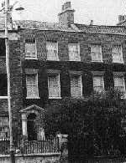
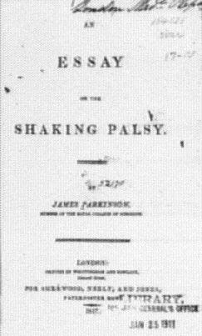
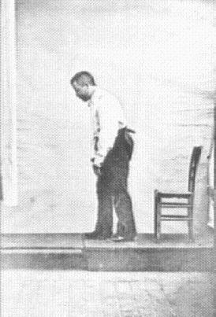
James Parkinson

Slide 4
What is Parkinson’s disease?
Chronic, progressive, neurological degenerative disease
degeneration of dopaminergic neurones in substantia nigra
80- 90% depletion of dopamine in the substantia nigra
Lewy bodies usually seen in PD but also seen in other conditions (i.e. Dementia)
Notes:
A chemical produced by the brain; it assists in the effective
transmission of electrochemical messages from one nerve cell
to the next. It is deficient in the basal ganglia and Substantia
Nigra of a person with Parkinson's. It governs actions of
movement, balance and walking.
The nigro-striatal pathways consist of dopaminergic
neurons which originate in the substantia nigra (black
substance) in the midbrain and project to the striatum (basal
ganglia), indirectly controlling involuntary motor movement.
Parkinson's disease results from degeneration of these
neurons with depletion of dopamine from the neuron
terminals and a loss of control of involuntary motor control
(tremor, rigidity, etc) mediated by the extra-pyramidal
pathways. This forms the basis for the administration of the
dopamine precursor, l-dopa as replacement therapy,
dopamine agonists, and drugs which indirectly facilitate
dopamine activit

Slide 5
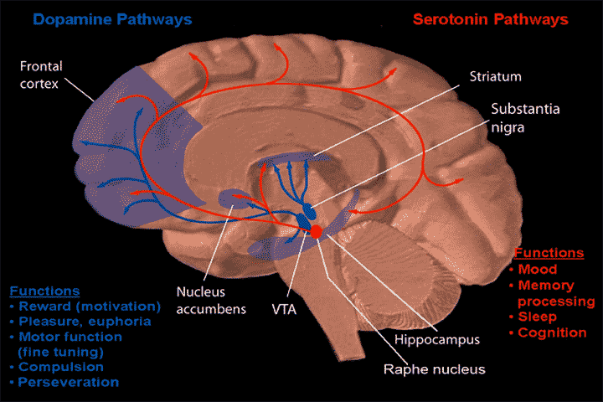
Pathology & Pathways
Reduced level of dopamine
Loss of dopaminergic cells in the substantia nigra
Other neurotransmitters: serotonin, acetylcholine
Symptoms of PD only manifest themselves: 70- 80% loss of dopaminergic cells
Notes:
The cause of PD itself and the characteristic of the disease is caused by a reduction in the amount of dopamine in the brain.
This drop in neurotransmitter is due to the gradual loss of the dopamine producing cells namely the dopaminergic cells in the substantia nigra.
However, it has been recently discovered that other chemicals in the brain are also involved in the disease such as serotonin ( happy hormone) and acetylcholine.

Slide 6
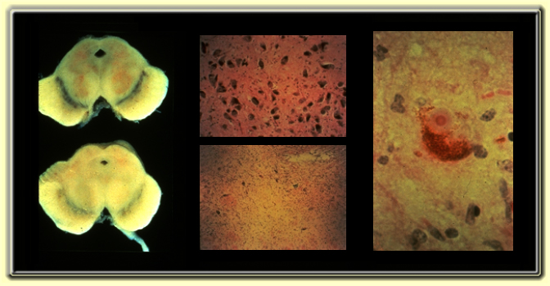
Pathology of Parkinson’s Disease

Slide 7

Lewy Body

Slide 8
Signs and Symptoms

Slide 9
Diagnostic criteria
Bradykinesia plus one of the following:
  resting tremor 4-6Hz ‘ pin rolling’
  Rigidity - lead pipe or cogwheeling
  disorders of posture - flexion of neck & trunk
  disorders of balance- loss of righting reflex
  disorders of gait - shuffling, festination, freezing,
Onset: Insidious, unilateral progressing to bilateral

Slide 10
Motor
Resting tremor
Mobility
Rigidity
Micrographia (small handwriting)
Dystonia (usually young onset)

Slide 11
Non motor
Bladder bowels drooling swallowing
Sleep: Rem behaviour disorders
Pain sex moods excessive sweating
Hallucinations paranoia concentration issues weight loss or gain
Falls posture balance vision
Cannot duel task

Slide 12
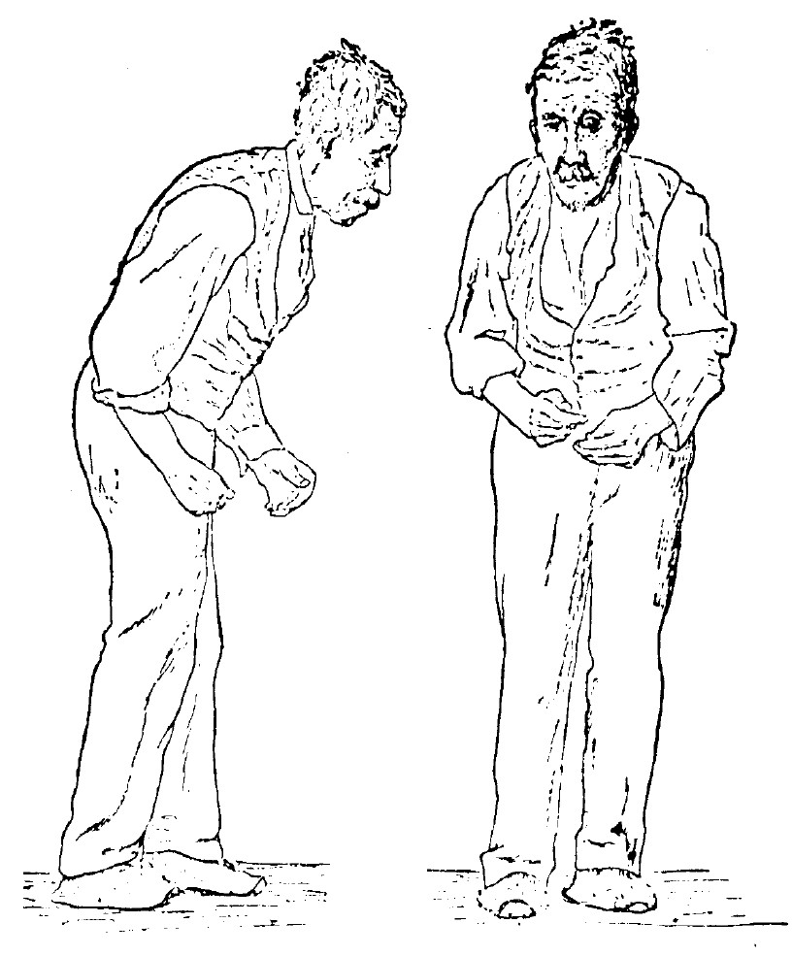
Typical PD features
Tremor Dominant
Akinetic type
Mixed Type
Muscle rigidity
Tremor
Bradykinesia - a slowing of physical movement
In advanced PD: akinesia - a loss of physical movement.
N.B: A range of non- motor symptoms
Notes:
As the picture shows a typical posture for a person with PD: stooped forward posture, shuffling gait, ‘poker’ face, postural instability.

Slide 13
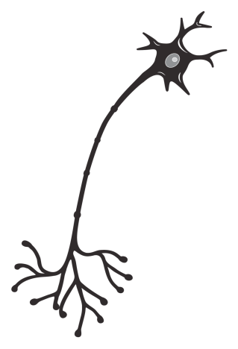
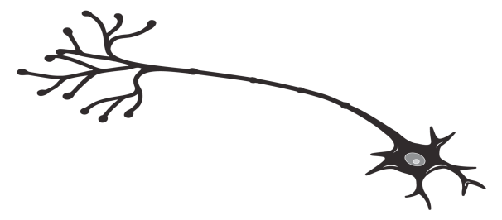

Constant levels of dopamine are vital for normal movement
In the brain, constant levels of dopamine are required to
  Regulate cortical excitation of striatal neurons
  Stabilize the firing rate and excitability of striatal neurons
  Modulate plasticity of striatal neurons (long-term potentiation)
Excitatory cortical input
Dopaminergic
regulatory input
Substantia
nigra
Striatum
Basal ganglia
Normal motor function
Olanow et al, 2006
Notes:
13
Dopamine exerts presynaptic modulation (in both up and down directions) on the glutamate-mediated excitation of striatal medium spiny neurons.
Most striatal neurons are medium spiny neurons that receive massive glutamatergic inputs from the cortex and thalamus
Regulation of this neuronal activity requires a precise selection mechanism (ie dopamine modulation) to filter incoming and outgoing signals associated with movement
Dopamine also acts postsynaptically to stabilise the firing rate and excitability of striatal neurons
It has also been recently shown that a key function of dopamine is to modulate glutamate-mediated long-term potentiation and long-term depression, thereby regulating plasticity of striatal neurons
Olanow et al. (2006) Lancet Neurol 5: 677–687

Slide 14
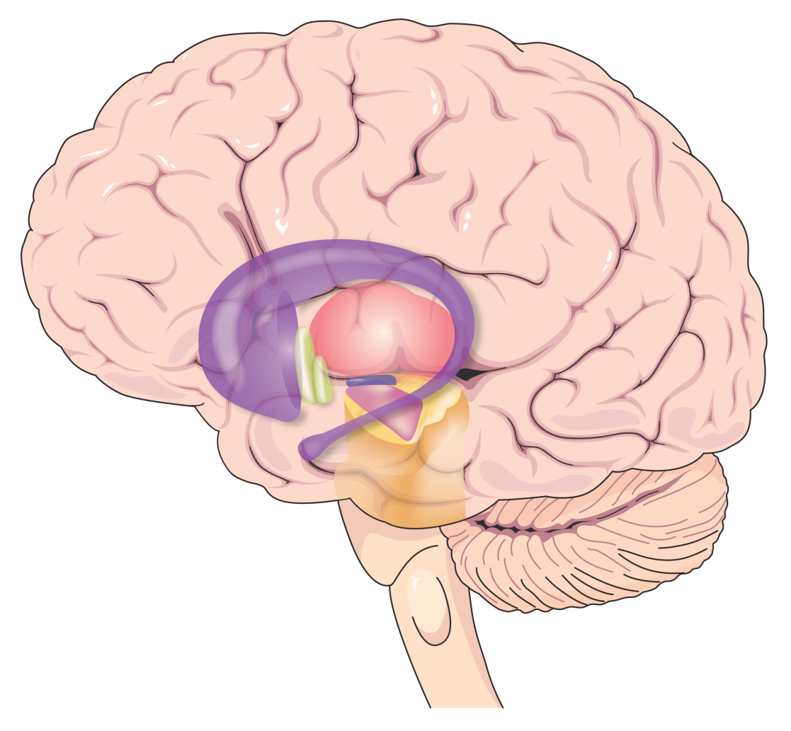
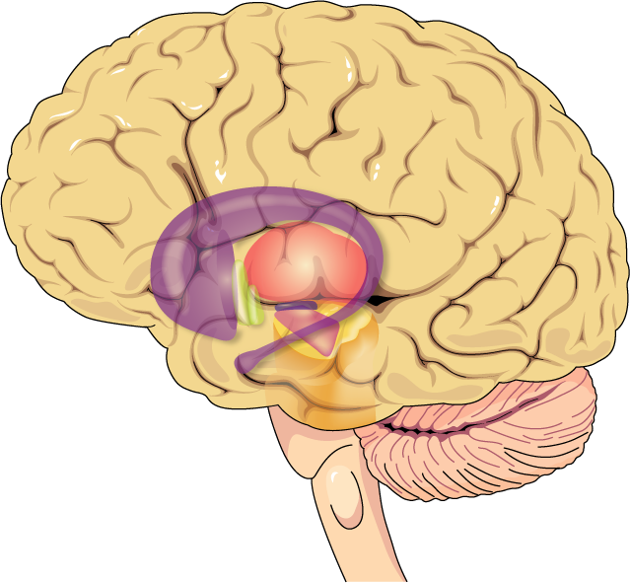
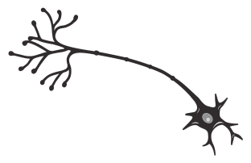
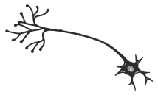
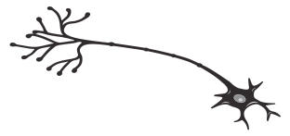
In PD, pulsatile delivery of traditional levodopa leads to pulsatile stimulation of dopamine receptors
Dopamine receptor state
Normal
Activated
Unactivated
Striatum
PD (untreated)
Substantia nigra
Activated
Unactivated
Nigrostriatal neurons
degenerate
Traditional levodopa
Activated
Traditional
levodopa
Unactivated
Notes:
14
With continued neuronal degeneration, plasma levodopa concentrations cannot be buffered and result in fluctuations in striatal dopamine levels
Under normal circumstances, dopamine neurons fire continuously, therefore, striatal dopamine receptors are normally exposed to relatively constant levels of dopamine and are in a constant state of activation
In PD, there is a progressive degeneration of nigral dopaminergic neurons and striatal dopamine levels become increasingly dependent on plasma levodopa concentrations
However, levodopa has a short plasma half-life and does not provide dopamine to striatal receptors in a continuous and physiologic manner
With continued neuronal degeneration, fluctuations in plasma levodopa concentration are translated into fluctuations in striatal dopamine levels and striatal dopamine receptors now become exposed to alternating high and low levels of dopamine resulting in ‘pulsatile stimulation’
Olanow et al. (2006) Lancet Neurol 5: 677–687

Slide 15
Normal Movement

Slide 16
















Dopamine
Striatal dopamine receptors
Nigrostriatal nerve terminals
Striatal neurone
Activated receptor
Normal neuronal function

Slide 17
Parkinsonian State

Slide 18


Striatal dopamine receptors
Nigrostriatal nerve terminals
Dopamine
Striatal neurone
Nigrostriatal nerve terminals
Activated receptor
Unactivated receptor
Normal neuronal function

Slide 19
Parkinsonian State with Intermittent Levodopa

Slide 20
Dopamine made from levodopa
Striatal dopamine receptors
Nigrostriatal nerve terminals
Striatal neurone
Activated receptor
Unactivated receptor
Normal neuronal function

Slide 21
Making a diagnosis
History
Examination
dopaminergic response
Time
SPECT or PET scans

Slide 22
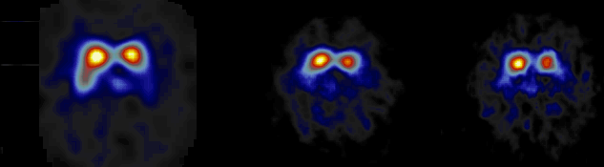
SPECT and progression
Baseline 15months 23months

Slide 23
Diagnosis
Constipation, reduced sense of smell, RBD, Micrographia, reduced mobility, younger patients tend to have dystonia, Restlesslegs, sleep problems.
MRI are usually normal DATS abnormal MIBG cardiac scans tell the difference between MSA and IPD.

Slide 24
Additional presenting symptoms
Facial
  impassivity, poverty of blinking,
Speech
  monotonous, hypophonic
Movement
  ↓ manual dexterity, rigid hands & arms ‘frozen shoulder’
Olfactory abnormalities
dribbling of saliva / swallowing difficulties

Slide 25
Cause of PD
Unknown in most cases
Genes
  13 identified
  AD inheritance very rare; mutation unknown
  mutation of Alpha synuclein gene identified in one large Italian and 5 Greek autosomal dominant families
  mutation of parkin gene in AR juvenile parkinsonism - Lewy body negative

Slide 26

Causes cont.
Environment
  Majority of cases believed caused by environmental factor (s) but none identified so far
Genes plus environment?
Genetic susceptibility

Slide 27
Parkinson’s disease risk factors
Definite: Old age
Highly likely: MZ co-twin with early- onset PD
Probable: Positive family history
Possible: Herbicides, pesticides, heavy metals, proximity to industry, rural residence, well water, repeated head trauma, etc.
Possible protective effect: Smoking

Slide 28
How common is Parkinson’s disease?
Incidence 20 per 100, 000
prevalence - 160 - 200 per 100, 000
approx 127, 000 people with PD in the UK (2013)

Slide 29
Oral and non oral medications
UK first line treatment is oral medications
USA can be DBS because they have less oral medications
Non oral therapies can be started as soon as symptoms start to fluctuate
Non oral therapies can include; physiotherapy OT SALT

Slide 30
Pharmacologic Treatment of Parkinson’s Disease

Slide 31
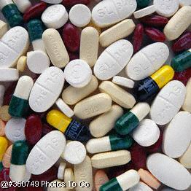
Drug Classes in PD
Dopaminergic agents
  Levodopa
  Dopamine agonists
COMT inhibitors
MAO-B inhibitors
Anticholinergics
Amantadine

Slide 32
Levodopa
Most effective drug for parkinsonian symptoms
First developed in the late 1960s; rapidly became the drug of choice for PD
Rapid peripheral decarboxylation to dopamine without a decarboxylase inhibitor (DCIs: carbidopa, benserazide)
Side effects: nausea, postural hypotension, dyskinesias, motor fluctuations

Slide 33
Levodopa Preparations
Co-Careldopa (Sinemet 62.5mg, Sinemet Plus 125mg)
Co-Cabenoldopa (Madopar Cps., soluble Madopar)
Stalevo (50mg,100mg,150mg,200mg, Combination Sinemet+Entacapone)
Duodopa

Slide 34
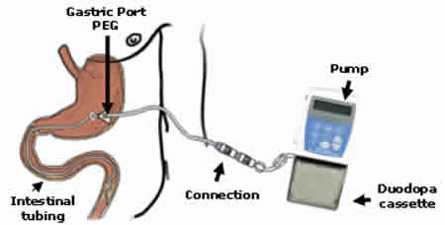
Duodopa Infusion

Slide 35
Is Levodopa Toxic?
Early patients develop motor fluctuations, but may be a function of neuronal cell loss
Increased life expectancy with LD introduction
LD-naive advanced PD patients develop fluctuations almost immediately with LD induction
Some believe continuous infusion may be safer than pulsatile therapy

Slide 36
Levodopa complications
Dose failure - Patient not aware of effect of individual dose
Mid-afternoon loss of benefit - super OFF
Loss of sleep benefit; early-morning akinesia, possible foot dystonia
Regular “wearing off” every 4 hours at first, shortens with time
Frequent wearing off, abrupt on-off, unpredictable dose response
Dyskinesia

Slide 37
Levodopa-Induced Dyskinesias
Manifestation of excessive dopaminergic stimulation
Typically late effect, and with higher doses
Narrowing of therapeutic window
Rare in LD-naive patients on DA monotherapy
Most common is “peak dose” dyskinesia
  disappears with dose reduction
Choreiform, ballistic and dystonic movements
Most patients prefer some dyskinesias over the alternative of akinesia and rigidity

Slide 38
Dopamine Agonists: Distinguishing Features
Directly stimulate dopamine receptors
No absorption delay from competition with dietary amino acids
Longer half-life than levodopa
Monotherapy or adjunct therapy
May delay or reduce motor fluctuations & dyskinesias associated with levodopa
May be neuroprotective

Slide 39
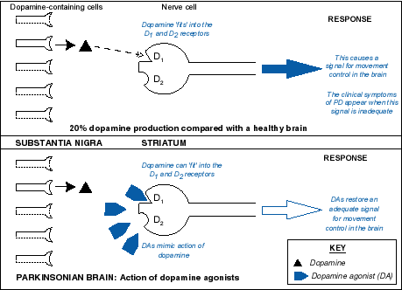
Action of DA ’s

Slide 40
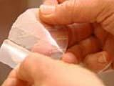
Dopamine Agonists (DA) used in PD
Pramipexole ( Mirapex,max.4.5mg salt base) both TDS and PR
Ropinirole/Ropinirole XL (Requip/Requip XL,max.24mg)
Rotigotine Skin Patch ( Neupro, max.16mg)
Cabergoline (Cabaser, max. 4mg)
Apomorphine (Apo-G0) SC continuing infusion or pen jets
(Pergolide,Bromocriptine) which are rarely used or are being with drawn

Slide 41
DAs: Common Adverse Effects
Nausea, vomiting
Dizziness, postural hypotension
Headache
Dizziness
Drowsiness & somnolence
Confusion, hallucinations, paranoia
pulmonary & retroperitoneal fibrosis; pleural effusion & pleural thickening; Raynaud’s phenomena. (May be more common with ergot derived DA’s)

Slide 42
Side effects
Pramipexole: compulsive eating,hyper sexuality, weight gain,
Requip: psychosis, hallucinations,paranoia,Reynard's type syndrome,
Apo-Go: hypersexuality
Cabergoline: hallucinations and illusions

Slide 43
Apomorphine
D1/D2 agonist
Parenteral delivery (s.c.)
Rapid “off” period rescue
  2-7 mg s.c pen injection systems
Treatment of unpredictable, frequent motor fluctuations
  continuous ‘waking hours’ s.c. (24hrs)infusion via mini-pump
SE: nausea, vomiting, hypotension
  domperidone 20 mg tds

Slide 44
apomorphine
Not a controlled drug
Not an opiate
Not addictive
Not an analgesic
An agonists runs via a continuous infusion or pen injection similar to diabetes

Slide 45
Apo-Go pen jets
Rescue remedy for off periods and for dystonia’s. (muscle cramping)
1-6mg
Pen for pain
Can be abused and again lead to paranoia and psychosis

Slide 46
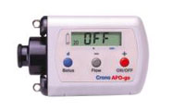
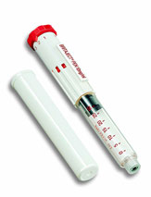
Apo-Go

Slide 47
COMT Inhibitors
Entacapone 200mgs (comb.Stalevo)
Potentiate LD: prevent peripheral degradation by inhibiting catechol O-methyl transferase
Reduces LD dose necessary for a given clinical effect
Helpful for fluctuating Parkinson’s disease
May be particularly useful for patients who fluctuate between off and on states frequently throughout the day

Slide 48
Entacapone
Dosage: 200 mg with each Levodopa dose.
Parkinson’s Study Group 1997: Increased on time by 5%, more in pts w/least on time
Rinne et al., 1998: Increased on time by ~10%; decreased Levodopa
Body fluids – reddish brown
Diarrhoea, dopaminergic SE’s

Slide 49
stalevo
Stavelo contains Entacapone and Levodopa combined.
Reduces the amount of tablets need to be taken when on combined entacapone and sinemet separately
50mg 75mg 100mg 150mg 200mg
200mg can be taken over night which last longer than sinemet CR

Slide 50
Amantadine
Antiviral agent; PD benefit found accidentally
Tremor, bradykinesia, rigidity & dyskinesias
Exact mechanism unknown; possibly:
  enhancing release of stored dopamine
  inhibiting presynaptic reuptake of catecholamines
  dopamine receptor agonism
  NMDA receptor blockade
Side effects —autonomic, psychiatric
100-300 mg/day usually 100mg BD morning and afternoon

Slide 51
Selegiline
Irreversible MAO-B inhibitor
Clinically active by inhibiting dopamine metabolism in brain
May be neuroprotective
Dosage: up to 5mg od
Side effects: insomnia, hallucinations, nausea (rarely)
Potential interactions with tricyclics and SSRI antidepressants

Slide 52
Rasagaline
1mg OD
Similar to selegeline affect without the amphetamine issues
replaces(newish Tolcapone (Tasmar) strict guidelines for use) Talcapone can only be used with monthly blood tests.

Slide 53
Anticholinergics
Dopaminergic depletion→ cholinergic overactivity
Initially used in the 1950s
Effective mainly for tremor and rigidity
Common agents (Start low, go slow):
  Benzhexol
  Orphenadrine
Side effects:
  Dry mouth, sedation, delirium, confusion, hallucinations, constipation, urinary retention
  Difficult to withdraw

Slide 54
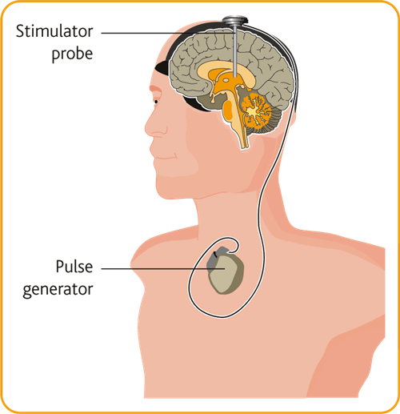
Deep Brain Stimulation (DBS)

Slide 55
Management of the Complex phase of PD
Motor
  ON/OFF fluctuations, dyskinesias, dystonia, freezing, falls
Behavioral / neuropsychological
  depression, sleep disorders, psychosis, apathy
Autonomic
  orthostatic hypotension; hyperhidrosis,(drooling) constipation, impotence, urinary incontinence or retention

Slide 56
complex
Living wills and directives
Power off attorney
Palliative care
Behaviours and management of psychiatric symptoms
Insight versus capacity

Slide 57
behaviours
Impulse control disorders
Dopamine dysregulation
Hedonistic
Risk takers
Pre-diagnostic personality
Controlled people and people who like to control
Insecure anxious natures

Slide 58
Impulse control disorder (icd)
Gambling hyper sexuality compulsions: eating, shopping, internet use, kleptomania
Hobbyinism, hedonistic behaviours,
Psychosis, paranoia, punding, night time eating
Obsessive behaviours in relationships
“become liars”

Slide 59
Dopamine deregulation (DDR)
The need to take more medication that is required to control symptoms
Excessive use of prescribed medications
The requirement to acquire medications usually from the internet to meet the “need”
Leading to hallucination psychosis and addiction

Slide 60
Hospital admission check list
Check diagnosis
Get an accurate list of medications and timings
Ensure the medications are given
Check last clinic letters if possible
Relatives and GP can be helpful
Check when the last medication was taken

Slide 61
Hospital admissions
Remember that PWP may be taking more medications than they admit.
Patients with addiction will hoard and hide drugs and keep extra supplies
To avoid withdrawal check when the last medication was given
Find a route to give medication if they have been put NBM.

Slide 62
NBM
Never NBM
Either NG Tube and dispersible madopar (co-beneldopa) equivalent to admission dose
Rotigotine patch at equivalent dose
Medication up to surgery and ASAP after.
ITU? Consider apomorphine pump

Slide 63
NBM
Think of Parkinsons as you would diabetes. Treat the same as far as making sure they get medications.
Patient admitted unwell leave the regime the same until the patient improves them review
Problems swallowing? Then patch or NG Tube

Slide 64
admission
Confused ? Cognitive issues? Aggressive?
Do not use haloperidol
Lorazepam 0.5mg IM Quetiapine or Rivastigmine patch
Vomiting? Nauseas? Domperidone orally or suppositories
No Maxalon (metoclopramide) or stemetil

Slide 65
admission
Dehydration (Parkinsons rarely feel thirsty)
Constipation (abdominal xray)
UTI
Chest infection/ aspiration (c-xray)
Low BP? Postural hypotension? (Parkinsons typically have low BP)
Hypertension sitting and when off and hypotension .

Slide 66
Agitated and confused Parkinsons
Ensure the patient gets their medications
Do not give haloperidol
Lorazepam 0.5mg IM
Rivastigmine patch 4.6mg 9.2mg
Quetiepine 12.5mg orally
Clozapine usually prescribed by the psychiatry team

Slide 67
Anti-emetic
Do not give maxalon or stemetil
Domperidone 10mg tds until it abates consider domperidone suppositories
Cyclazine can be used with caution but usually at palliative care stage and short term used only

Slide 68
admission
Never NMB . Think what next.
NG Tube/Rotigotine patch
Never use haloperidol.
NO maxalon or stemetil
Domperidone 10mg orally tds or suppositories
Theatre? Drugs right up to anaesthetic and straight after .

